Slide 1
The Repository Ecosystem
An Introduction
Jim Hamilton
The Hosting Project
24 February, 2021

Slide 2
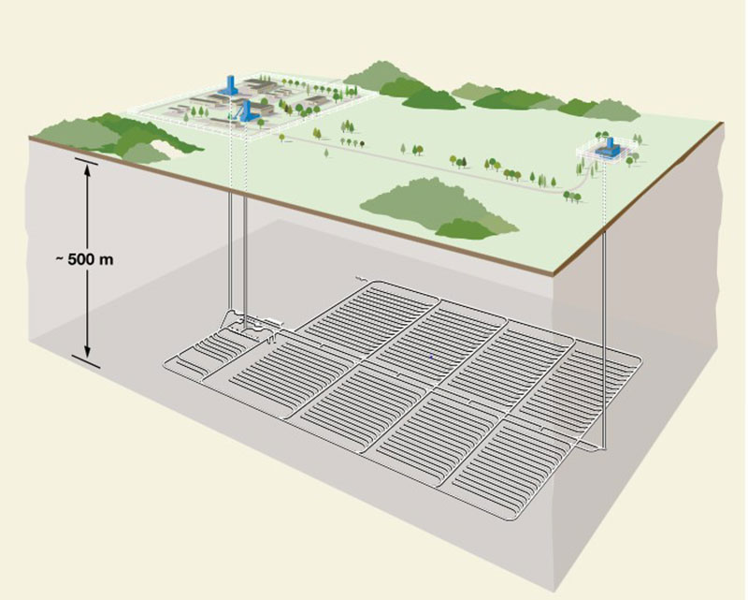

Slide 4
Willing & informed consent
Social and environmental justice
Defined roles and responsibilities of local, state and federal entities
Fairness

Slide 5
Fairness
Safety
Regulatory approvals
Technical and scientific integrity
Trusted information
Social dimensions of safety and risk

Slide 6
A thriving host community, and region, for generations.
Repository as an engine for the advancement of a region’s:
Social capital
Educational capital
Ecological capital
Spiritual capital
Physical capital
Economic capital
Regenerative planning as a process tool
Fairness
Safety
Prosperity

Slide 7
Fairness
Safety
Prosperity
The Repository Ecosystem

Slide 8
Thank You
jim@thehostingproject.org

