Slide 1
Defense High-level waste
ENGAGING LOCAL GOVERNMENTS
AND BUILDING SUPPORT
Kara Colton
Director, nuclear programs
Energy communities alliance
February 24, 2021

Slide 2
Energy communities alliance
ECA is the national, non-profit organization of local governments adjacent to and impacted by DOE nuclear activities
Hosts to federally-owned and operated nuclear facilities (including all DOE defense and non-defense wastes)
Long-term experience working with DOE, Congress, states and industry
Potential hosts for new nuclear missions – nuclear waste storage/disposal, power production, fuels, recycling

Slide 3
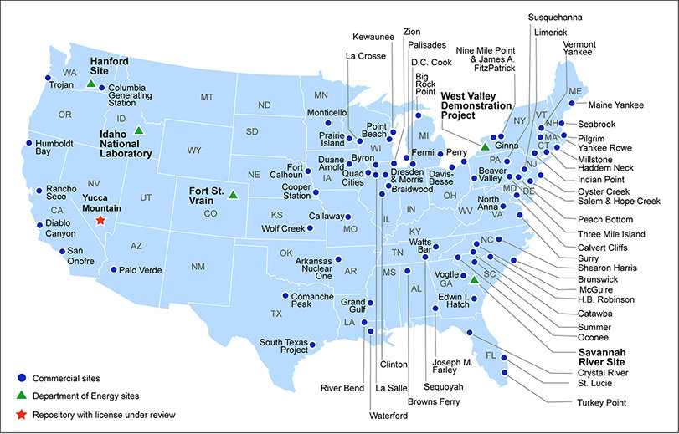
Current storage sites for hlw/snf in the us
Source: U.S. Department of Energy

Slide 4
Role of local governments
Local governments and communities are responsible for:
Education and outreach to the community
Education and outreach to the state, regional, federal decision-makers and industry
Negotiation on behalf of the potential host community
Protection of public and environmental health and safety
Securing a viable economic future

Slide 5
Efforts to address waste management
Interagency Review Group on Nuclear Waste Management (1978)
Nuclear Waste Policy Act of 1982
Nuclear Waste Policy Act Amendments of 1987 – Designates Yucca Mountain
DOE formally submits license application to NRC for construction of permanent repository at Yucca Mountain (2008)
Motion filed to withdraw Yucca Mountain license application (2010)
Blue Ribbon Commission on America’s Nuclear Future (2010)
Blue Ribbon Commission Final Report Recommends Consent-Based Siting (2012)

Slide 6
Efforts to address waste management
The Strategy for the Management and Disposal of Used Nuclear Fuel and High-Level Waste Radioactive Waste (2013)
        Pilot interim storage facility to be sited, designed, licensed, constructed and opened by 2021
        A larger interim storage facility to be sited, licensed and available by 2025
        A geologic repository to be opened by 2048
Authorization to evaluate a separate repository for high-level radioactive waste from atomic energy defense activities (2015)

Slide 7
Efforts to address waste management
Nuclear Waste Administration Act of 2013/Nuclear Waste Administration Act of 2015
Deep Borehole Feasibility (Rugby, North Dakota)
Consolidated Interim Storage license applications submitted to NRC by Interim Storage Partners and Holtec International (2016/2107)
Secretary-Nominee Granholm says Biden Administration “opposes the use of Yucca Mountain for disposal of nuclear waste” supports “consent based siting” (2021)

Slide 8
2012 Blue ribbon commission recommendations
A new, consent-based approach to siting future nuclear waste management facilities.
A new organization dedicated solely to implementing the waste management program and empowered with the authority and resources to succeed.
Access to the funds nuclear utility ratepayers are (were) providing for the purpose of nuclear waste management.
Prompt efforts to develop one or more geologic disposal facilities.
Prompt efforts to develop one or more consolidated storage facilities.
Prompt efforts to prepare for the eventual large-scale transport of SNF and HLW to consolidated storage and disposal facilities when such facilities become available.
Support for continued US innovation in nuclear energy technology and for workforce development.
Active US leadership in international efforts to address safety, waste management, non-proliferation and security concerns.

Slide 9
2017 Eca recommendations – federal level
“Regardless of the path forward ECA is urging DOE, Congress and the Administration to maintain transparency, collaboration,
respect for taxpayer dollars already spent, and momentum.”
Finish the Yucca Mountain licensing review or pass legislation to modify the Nuclear Waste Policy Act
Continue working with local governments, communities, states and tribes to define and identify components of “consent”
Identify the necessary process – including the order that each step should be accomplished – to move a consent-based siting process forward

Slide 10
2017 Eca recommendations – federal level
Congress/the Administration must provide resources and funding for education, outreach, feasibility studies and research and development aspects for waste management and disposal
    Assist local governments and communities interested in hosting sites or involvement in waste management and disposal missions to educate the local community and hire independent third-party scientists and engineers.
Create entity focused on HLW and SNF management empowered to consent on behalf of the federal government
Develop a list of suitable disposal mediums (salt, granite, etc.) and indicate where they exist to inform feasibility studies

Slide 11
2017 Eca recommendations – federal level
Develop an initial list of opportunities/compensation available to potential hosts of nuclear storage/disposal missions
DOE, NRC, EPA develop scientifically-based health and environmental standards, model state laws and regulations to guide siting process
If progress cannot be made, communities that have become de facto interim storage sites for both defense and commercial HLW/SNF should receive funding from the federal government to offset the impacts of storing waste beyond the timeframe originally expected.

Slide 12
Apply lessons learned
  Extended consent-based siting process
  Recognition of national need
  Existence of a clear benefit for citizens of state and local jurisdiction where repository is located
  Foundation of strong local support
  Competent technical oversight by the State (WIPP and State of New Mexico)
  Intense and early outreach
  Rigorous quality assurance from the earliest stages of the project such a traceability, transparency and independent review
  Credibility
  Local government and community support alone will not lead to successful siting – support from the state government is necessary
  Clarify impacted stakeholder versus interested party

Slide 13
defining consent
  Transparency – The potential host community and state must be engaged throughout the process and trust that their interests, concerns and priorities are recognized and meaningfully considered.
Flexibility – The terms and conditions under which a specific community will host a facility must be reflected in any agreement – there is no “one size fits all”
Education – Local governments and states must be given the resources to provide education and outreach to explain benefits and risks
Based on standards and science – Data should not only come from the federal government, potential host communities must be able to hire their own independent experts
Legally enforceable

Slide 14
what to consider in consent agreements
ECA Recommendations
  Long-term funding for technical assistance and education of the community for affected local governments (by the communities consultants)
  Regulatory oversight authority
  Clear technical parameters for the project – including volume limitations
  Legally enforceable milestones
  Penalties for failure to meet obligations
  Linking storage and final disposal
  Financial compensation/incentives and economic development assistance
  Triggers for termination
  Indemnification for communities, states and tribes
  Opportunities for future nuclear missions and economic development opportunities

Slide 15
Recognize progress
Local communities around the country have volunteered to accept waste
States are requesting resources to study issues related to nuclear wastes (the federal government should fund these)
Record of safe transportation and movement of nuclear waste across the complex
Progress on rail car design for transportation of HLW/SNF
DOE shift to define waste based on radiological content versus origin introduces risk-based, safe alternative disposal path for some waste
NRC licensing - Holtec (Eddy Lea Alliance, NM) and Waste Control Specialists (Andrews County, TX) moving forward with interim storage facility development

Slide 16
Recognize outstanding challenges
Lack of clarity/path forward at DOE
Politics
Trust
Timeline/Sense of urgency
Need agreement on elements of “consent”
Prioritization of government-owned/generated HLW
Assured funding not based on annual appropriations
Resources for education, outreach and feasibility studies
Impact on DOE Cleanup Program
Impact on development of new nuclear technologies and projects?

Slide 17
Next steps FOR LOCAL GOVERNMENTS
DOE should re-engage with local governments again now
Fund states and local governments that are interested in setting up a program or process
Ensure and promote opportunities for public input at the federal, state and local level
Identify resources and partners needed for education, feasibility and technical studies
Begin outreach efforts:
    Identify “trusted” local champions
    Host meetings in impacted communities with site managers, contractors, utilities and economic development entities
    Create public information centers and campaigns
    Coordinate with local universities, community colleges and vocational schools
    Develop websites and written materials for distribution outlining pros and cons of nuclear initiatives

Slide 18
QUESTIONS?
KARA COLTON
DIRECTOR OF NUCLEAR POLICY
ENERGY COMMUNITIES ALLIANCE
(703) 864-3520
KARA.COLTON@ENERGYCA.ORG

